Slide 1
VEX: Vetting Browser Extensions For Security Vulnerabilities
Sruthi Bandhakavi, Samuel T. King, P. Madhusudan, Marianne Winslett
University of Illinois at U-C
In USENIX Security 2010 (best paper)
Presented by Bo Sun

Slide 2
Contents
Acknowledgement
Introduction to Firefox and Extensions
Motivation
Goal
Procedure
Results
Conclusion
Criticisms
Positive, Negative, Improvement

Slide 3
Acknowledgements
Original Authors
Website screen capture
google.com, firefox.com
The rest (see references)

Slide 4
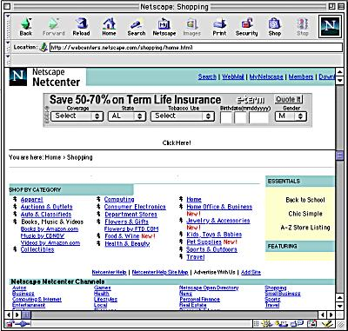
Evolution of the Browser
Netscape, circa 1995 [4]
Web browser handles mostly static content from HTML

Slide 5
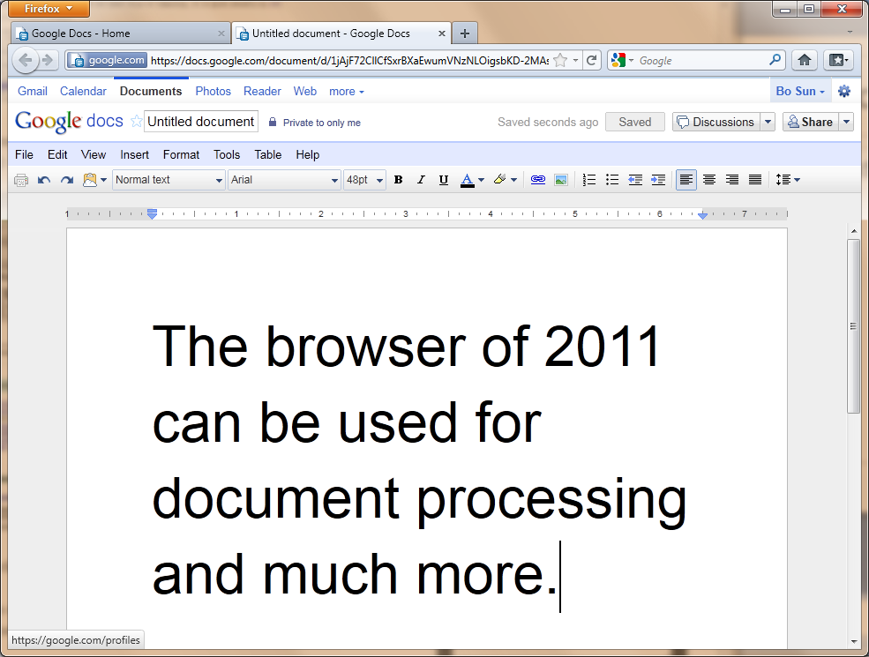
Browser 2011
Firefox 4.0 2011
More than a browser
A platform for computing [5]
Notes:
Show the impact of browser technology and how powerful it has become. With great power comes great responsibility. Such power comes at a price.

Slide 6
Extensions
Extensions, or “add-ons” enable additional (javascript) computation by the web browser and has typically equal privilege to the browser
Extensions can:
Block advertisements/scripts (Adblock Plus)
Alter the “look and feel” of webpages (Stylish)
Aid development of webpages (Firebug)
Do many other things

Slide 7
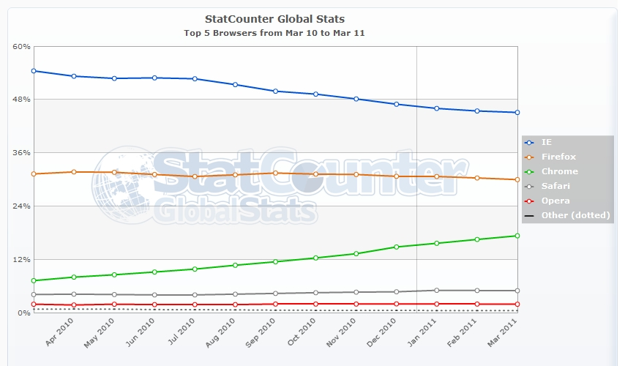
Paper revolves around Firefox
Paper would be more accurately titled as “Vetting Firefox Extensions…”

Slide 8
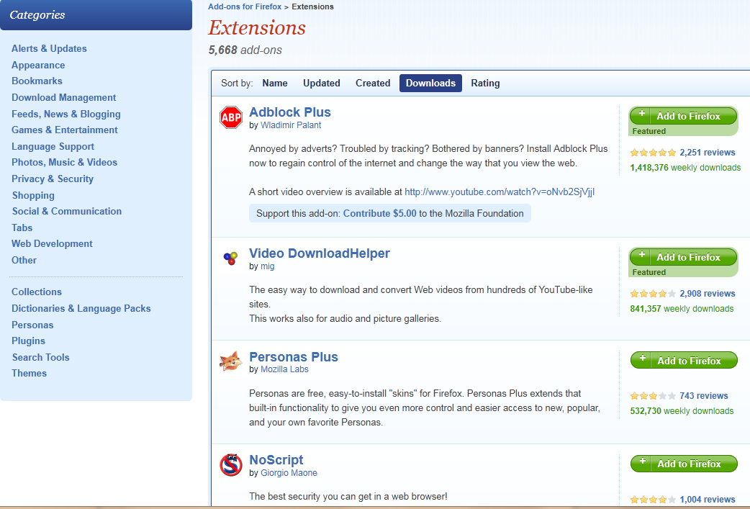
Firefox Extensions

Slide 9

Topic
Automated Auditing (“vetting”) of Firefox Extensions
Notes:
One-third of all Firefox users have an addon

Slide 10
Vulnerabilities
“Malicious toolbars and extensions try to hijack browsers” -Ars Technica [1]
“Malicious Firefox Add-ons Installed Trojans” -PC World [2]
“Firefox plug-in Trojan harvests logins”
-The Register [3]
“tens of extensions have been discovered in the past few years” [5]

Slide 11
Vulnerabilities
There are also vulnerabilities from “benign-but-buggy” extensions[6]
Untrusted Webpage w1
Extension javascript.foo(w1)
Extension is hi-jacked
Notes:
Conceptually similar to buffer overflow.

Slide 12
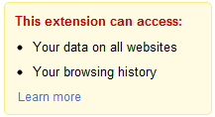
Fighting Vulnerable Extensions
Chrome 10
Expose risk level to user
Enforce restrictions on extensions
User reviews and comments
Firefox
Vetting (auditing) of code by volunteers
User reviews and comments

Slide 13
More on Vetting
Vetting typically requires many man-hours and expert level knowledge
Current grep-based automation only cover syntactic bugs and vulnerabilities and rely on human judgment for detecting unsafe program flow
Many false positives from grep

Slide 14
VEX
Authors introduce a tool called VEX in order to automate more of the vetting process
VEX Provides static information flow analysis
“Identify explicit information flows from injectable sources to executable sinks”
The paper also differentiates patterns and flows but in this presentation, both are simply refer to both as flows

Slide 15
Motivation for using VEX
Reduce the number of man-hours required for vetting
Provide consistent vetting
Increase the coverage of vetted extensions
Static analysis does not incur runtime overhead

Slide 16
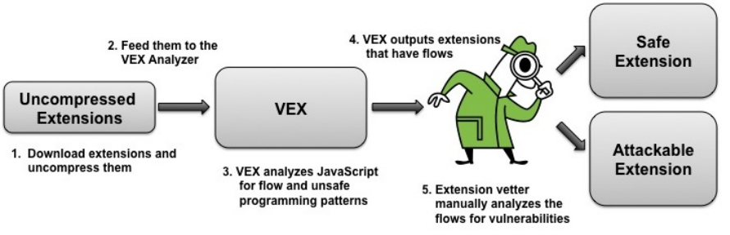
The role of VEX
Previously, an expert would take the role of VEX

Slide 17
Procedure

Slide 18
Recall VEX’s goal
“Identify explicit information flows from injectable sources to executable sinks”
Executable sink
The method or location where some malicious input can take control
For example, where format string attacks on unguarded stacks can happen
Injectable source
For example, the string variable of the unsafe function

Slide 19
Points of Attack
Type | Description
eval() | String to JavaScript code, and then execution.
evalInSandbox() | Executes unsantized JavaScript code in a restricted JavaScript object. Calling “==“ instead of “===“ may run with unrestricted privilege.
innerHTML | <img src=“foo.jpg” onload=“bar.js”></img> Extensions may change bar.js inadvertently into some attack code.
wrappedJSObject | Manual override function to run modified document object.

Slide 20
Information Flow
Recall again VEX’s goal
“Identify explicit information flows from injectable sources to executable sinks”
VEX Identifies explicit information flow via tainting at a very fine grained level
Building of an “Abstract Heap”
Represent the information flow

Slide 21
Abstract Heap Diagram
An Abstract Heap for every Extension.js
var
Extension.js

Slide 22
Building an Abstract Heap
A description JavaScript code as
Graph of nodes (function and nodes)
Dependence relation between variable and nodes
ns, n, d, fr, dm define the graph
tm defines the dependence of variables and nodes

Slide 23
Sample Abstract Heap
Dependence map dm
void foo(string bar) {
Object ob;
ob.dotask(bar)
}
foo(bar)
ob
dotask(bar)

Slide 24
Turning Javascript to a Heap
Javascript Code is labeled (RETURN, WHILE, CONDITIONAL, VARIABLE, CONSTANT, etc)
Figure 2
Interaction between Labels and the Abstract Heap are then defined semantically
Figure 2, 3

Slide 25
Example
When the code below is encountered…
It is labeled as a COND and will interact with Abstract Heap σ semantically by:
if(a) { S1; }
else { S2; }

Slide 26
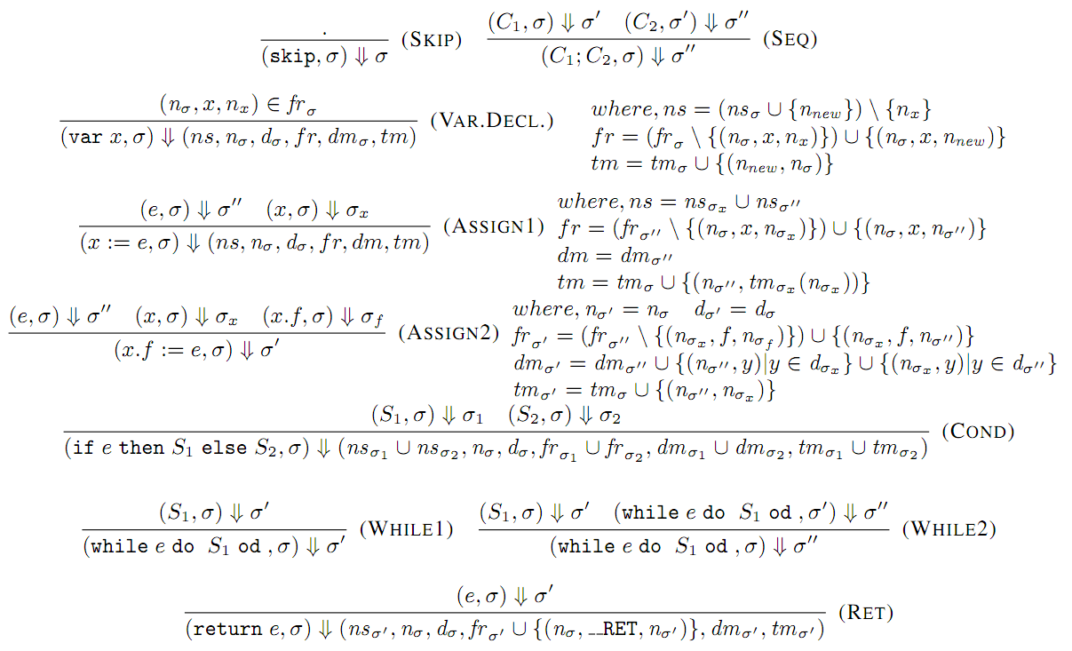
Many, Many Interactions

Slide 27
Takeaway
Once the Abstract Heap is built from the JavaScript code of the extension, we can know the fine-grained information flow
Unsafe flows can then easily be identified by referencing the Abstract Heap (Section 5 gives details)

Slide 28
Results

Slide 29
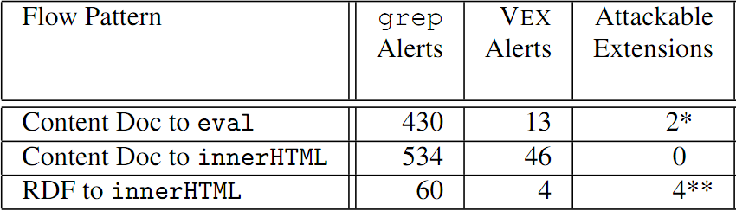
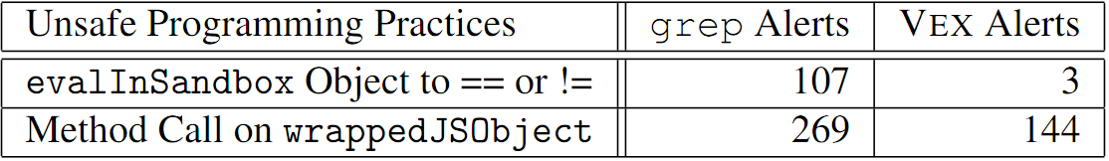
Results
Much lower False Positive Rate than grep-based analysis! Tested on 2452 extensions.

Slide 30
Discussion
Identified previously unknown vulnerabilities
Wiki Toolbar 0.5.9
Clicking on a toolbar button while at malicious site
Fizzle 0.5.1/0.5.2 (RSS Reader)
Arbitrary RSS feed injects attack code into Fizzle

Slide 31
Contribution
Created a usable system which greatly aids the vetting process
Found bugs that escaped the eye of human experts
Made the internet safer for hundreds million Firefox users with extensions
roughly 185 milliion Firefox users with extensions

Slide 32
Weakness
Diagram 3 & 4 would be better suited in an appendix
Still requires 2 hours per extension to manually inspect VEX alerts
Vulnerable code that slips through VEX is unprotected

Slide 33
Improvement
Define more explicit information flows that are dangerous
Current implementation offer partial coverage
Automate build attack vectors

Slide 34
References
[1] Jeremy Reimer. Ars Technica. 2006. (http://arstechnica.com/old/content/2006/07/7360.ars)
[2] Erik Larkin. PC World. 2010. (http://www.pcworld.com/article/188651/malicious_firefox_addons_installed_trojans.html)
[3] John Leyden. The Register. 2008. (http://www.theregister.co.uk/2008/12/04/firefox_plug_in_trojan/)
[4] Avinash Meetoo. A Guided Tour of the Internet. 2011. (http://www.noulakaz.net/weblog/author/avinash/)
[5] S. Bandhakavi, S. T. King, P. Madhusudan, and M. Winslett. VEX: Vetting browser extensions for security vulnerabilities. In USENIX Security, 2010.
[6] A. Barth, A. P. Felt, P. Saxena, and A. Boodman. Protecting browsers from extension vulnerabilities. In Proceedings of the 17th Network and Distributed System Security Symposium (NDSS), San Diego, CA, February 2010

